Slide 1
Digital Signal Processing
Dr. Michael Nasief
Lec 6

Slide 2
Chapter [2]
Fourier Analysis

Slide 3
INTERCONNECTION OF SYSTEMS

Slide 4
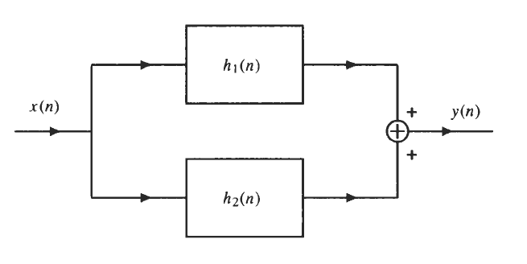

Slide 5
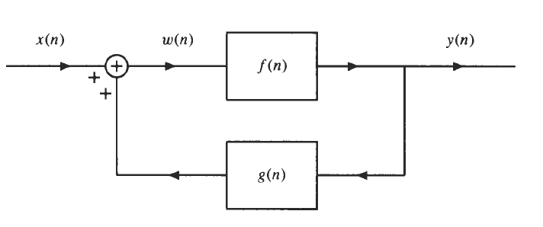
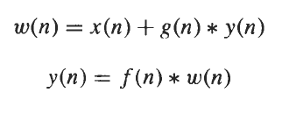
Feed Back

Slide 6
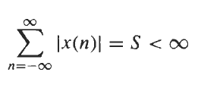
THE DISCRETE-TIME FOURIER TRANSFORM
The discrete-time Fourier transform (DTFT) of a sequence, x(n), is defined as
In order for the DTFT of a sequence to exist, the summation in Eq. (2.3) must converge. This, in turn, requires that x(n) be absolutely summable:

Slide 7
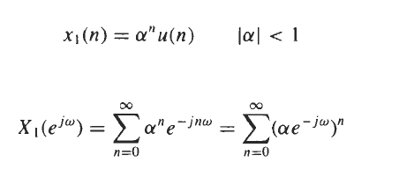
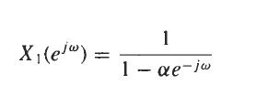
EXAMPLE

Slide 8
IDTFT

Slide 9
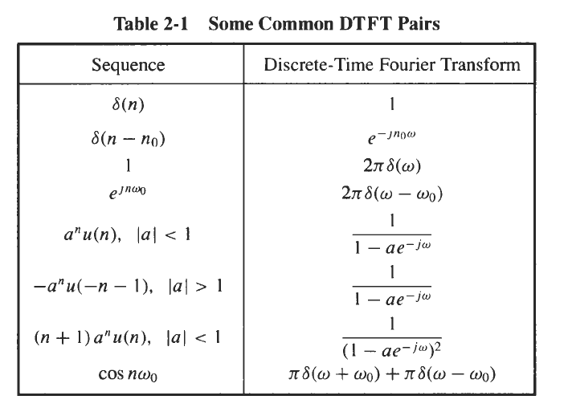

Slide 10
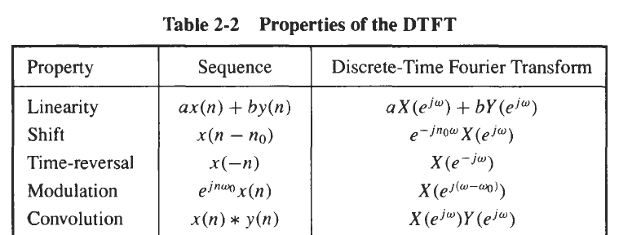

Slide 11
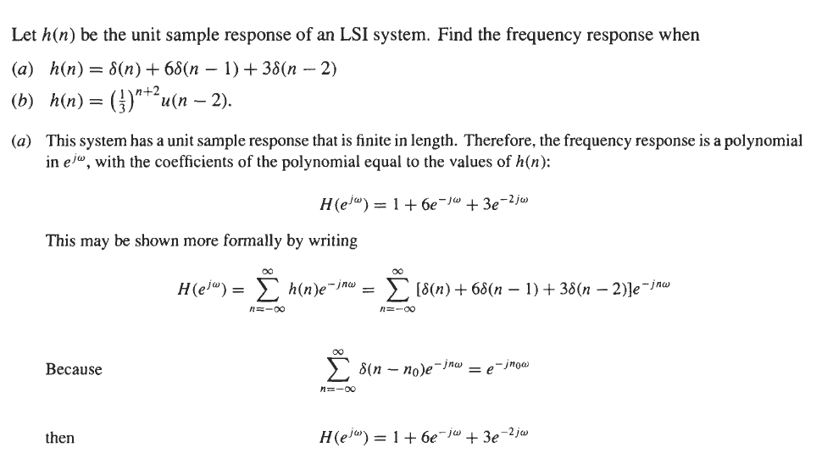
Problems

Slide 12
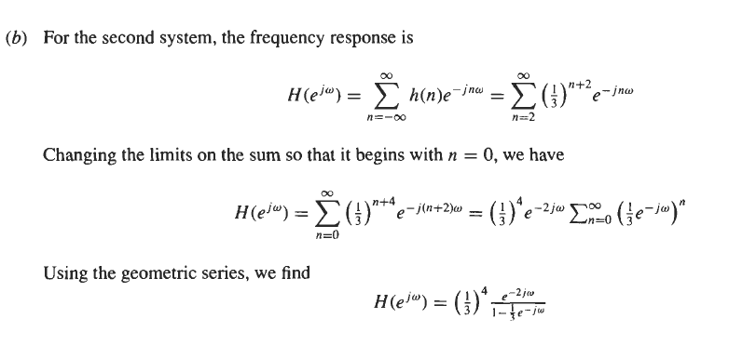

Slide 14
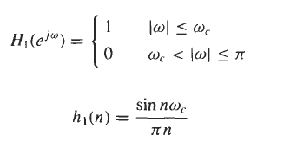
Notes

Slide 15
Note

Slide 16
